Slide 1
Test Automation in a Successful Digital Transformation Journey
Notes:
‹#›

Slide 2
Agenda
Introductions
Top Technical Challenges in Application Development
Digital Transformation
Is Test Automation a Solution?
Facilitating Test Automation
Conclusion
Question and Answer
Notes:
Tutorial TPI NEXT for BRATESTE 2011
3/16/16
© Polteq Test Services B.V. 2011
‹#›

Slide 3
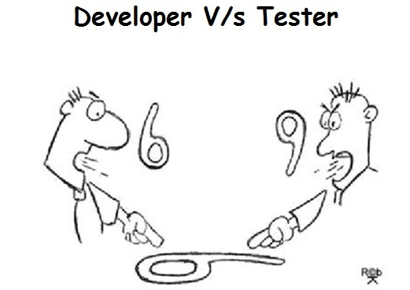
Introductions
Wayne Sinclair
Consultant at Thoughtworks
@tester_RSA
sinclair@thoughtworks.com
waynesinclair.co.za
Notes:
Tutorial TPI NEXT for BRATESTE 2011
3/16/16
© Polteq Test Services B.V. 2011
‹#›

Slide 4
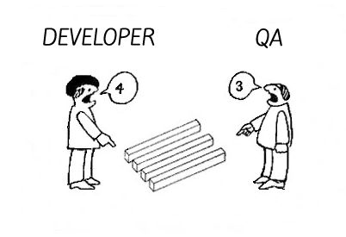
Introductions
Mboneni Radebe
Consultant at Thoughtworks
@Zululegend
mradebe@thoughtworks.com
Notes:
Tutorial TPI NEXT for BRATESTE 2011
3/16/16
© Polteq Test Services B.V. 2011
‹#›

Slide 5
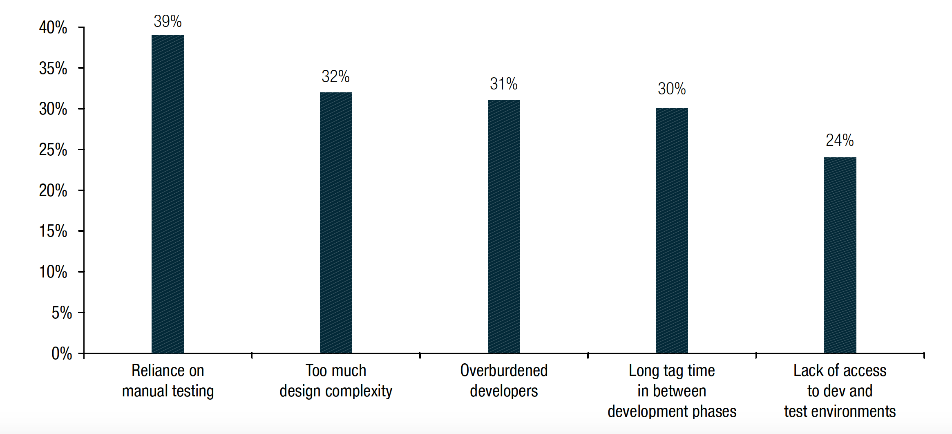
Top 5 Technical Challenges in Application Development
https://www.capgemini.com/resources/world-quality-report-2015-16
Notes:
Insert notes here – why over-reliance on manual testing is a challenge
Sogeti, HP, Capgeti

Slide 6
Digital Transformation
Re-aligning and investing in new technology and business models with a specific focus on the customer experience
https://www.accenture.com/_acnmedia/Accenture/Conversion-Assets/DotCom/Documents/Global/PDF/Digital_2/Accenture-Digital-Transformation-In-The-Age-Of-The-Customer.pdf
Notes:
Tutorial TPI NEXT for BRATESTE 2011
3/16/16
© Polteq Test Services B.V. 2011
‹#›
Definition of “Digital Transformation” from Forester Consulting Thought Leadership Paper - “Digital Transformation in the Age of The Customer”
Rich, secure, multi-channel, consistent
Critical to survival
Rapid adoption of Agile
Accelerate delivery,
Meet needs of customer
Companies are actively working to transform their
organization,
processes,
and technology
in pursuit of a more effective digital business and a more satisfying customer experience
We need to keep pace with digital transformation initiatives
Companies on digital transformation journey are spending the most on QA and testing

Slide 7
Digital Transformation
General impact of digital transformation
Focus shifting to customer
Multi-Channel
Speed to market
Deliver faster
Maintain quality & user experience
Notes:
Tutorial TPI NEXT for BRATESTE 2011
3/16/16
© Polteq Test Services B.V. 2011
‹#›
Key drivers of digital transformation are profitability,customer satisfaction, and increased speed-to-market
Improving customer experience and growing revenues are top strategic priorities.
Online and cross-channel customer experiences are getting the most attention in 2016
New approaches
Test environments
Digital capabilities
Mobile solutions
Cloud
Change of focus to UX
Top 3 priorities (Get diagram) ?
Protecting the corporate image
Ensure end user satisfaction
Increase quality awareness across all disciplines
We need to keep pace with digital transformation initiatives
Companies on digital transformation journey are spending the most on QA and testing
Key testing challenges identified
Achieve meaningful testing in shortening timeframes
How to achieve maximum automation
Transform from testing and validation before go-live to more predictive forms of testing and real time quality monitoring (???? P16)_ / Data Analytics

Slide 8
Digital Transformation
Impact on QA and testing
Support faster software delivery, not become bottleneck
Manually testing is costly and time consuming
New approaches
Notes:
Tutorial TPI NEXT for BRATESTE 2011
3/16/16
© Polteq Test Services B.V. 2011
‹#›
Key drivers of digital transformation are profitability,customer satisfaction, and increased speed-to-market
Improving customer experience and growing revenues are top strategic priorities.
Online and cross-channel customer experiences are getting the most attention in 2016
New approaches
Test environments
Digital capabilities
Mobile solutions
Cloud
Change of focus to UX
Top 3 priorities (Get diagram) ?
Protecting the corporate image
Ensure end user satisfaction
Increase quality awareness across all disciplines
We need to keep pace with digital transformation initiatives
Companies on digital transformation journey are spending the most on QA and testing
Key testing challenges identified
Achieve meaningful testing in shortening timeframes
How to achieve maximum automation
Transform from testing and validation before go-live to more predictive forms of testing and real time quality monitoring (???? P16)_ / Data Analytics

Slide 9
Is Test Automation a Solution?
Notes:
Tutorial TPI NEXT for BRATESTE 2011
3/16/16
© Polteq Test Services B.V. 2011
‹#›
Holistic test strategy approach
Why do you want to implement test automation?
Where do you want test automation to add more value?
Does your organisation have the necessary maturity and skills?
Do you have the test infrastructure?

Slide 10
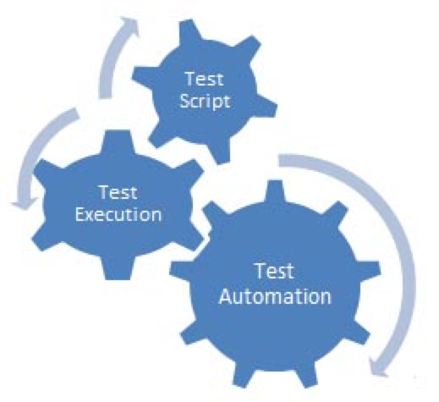
What is Test Automation
The use of special software (separate from the software being tested) to control the execution of tests and the comparison of actual outcomes with predicted outcomes
Notes:
Tutorial TPI NEXT for BRATESTE 2011
3/16/16
© Polteq Test Services B.V. 2011
‹#›

Slide 11
Test Automation Failures
No clear test automation strategy
Automation thought to be just record and playback
Not treating automation as software development
Thinking a test automation tool will solve your problems
Notes:
Tutorial TPI NEXT for BRATESTE 2011
3/16/16
© Polteq Test Services B.V. 2011
‹#›
Focus points:
Deliberate on the three points and give examples
Automation only being at GUI level

Slide 12
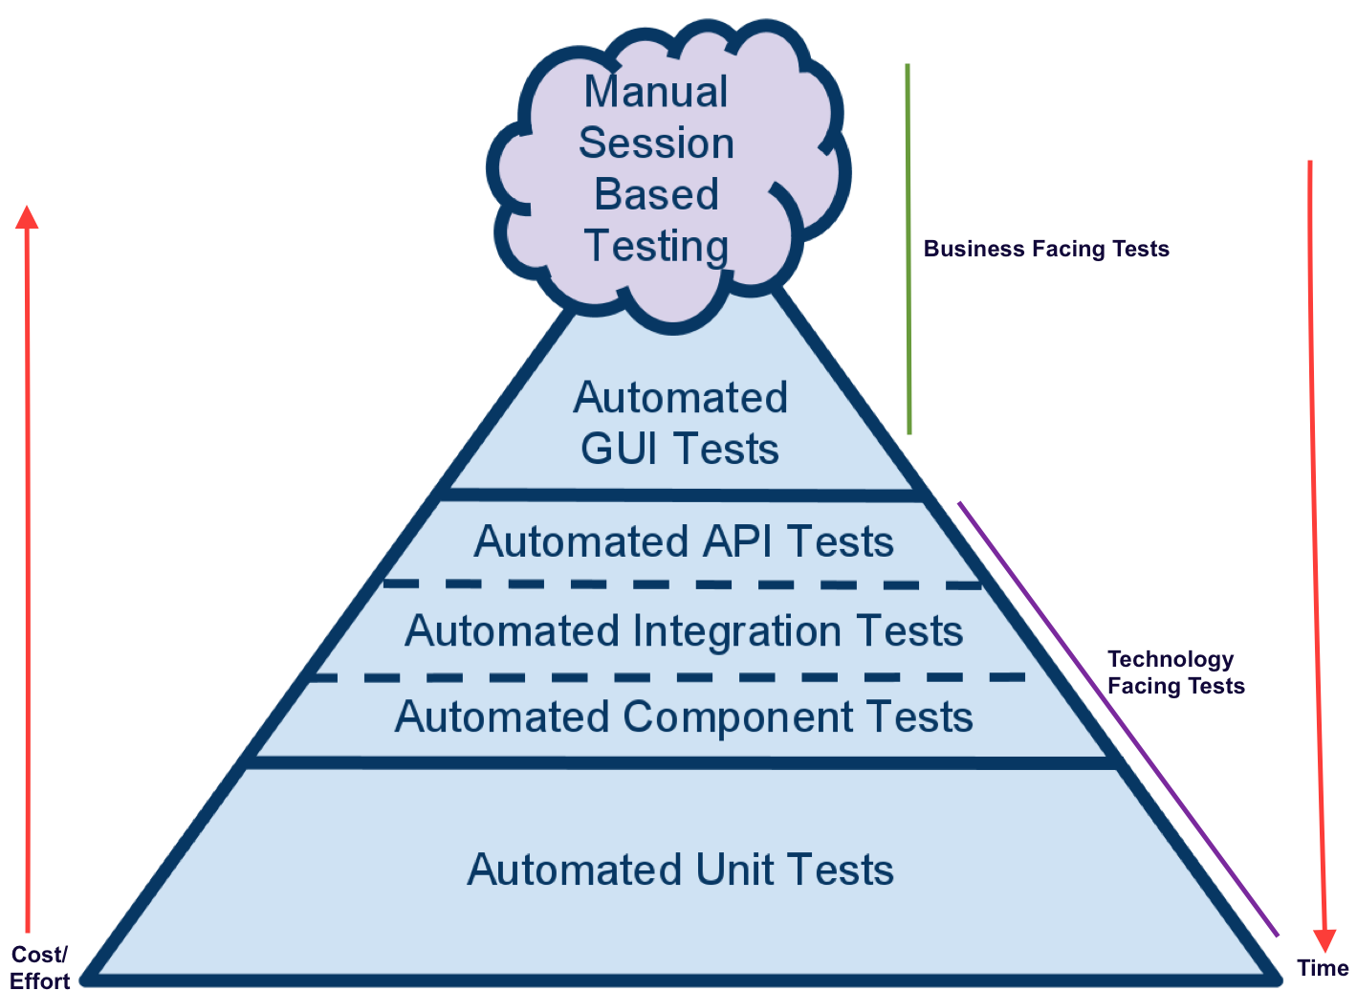
Adopting a Full Test Automation Strategy That Leads to Success
Are we building the right system?
Are we building the right system?
Are we building the system right?
Are we building
Notes:
Ask a question,can we adopt a fully automated test strategy
Test pyramid shows the mix of tests we should aim for
Impact on time to production with focus being on Quality code
Time to market is shortened as there is reduced dependency on manual testing
Business facing tests = Manual and Automated GUI tests = Difficult to maintain
Technology facing tests = Unit + Service layer tests

Slide 13
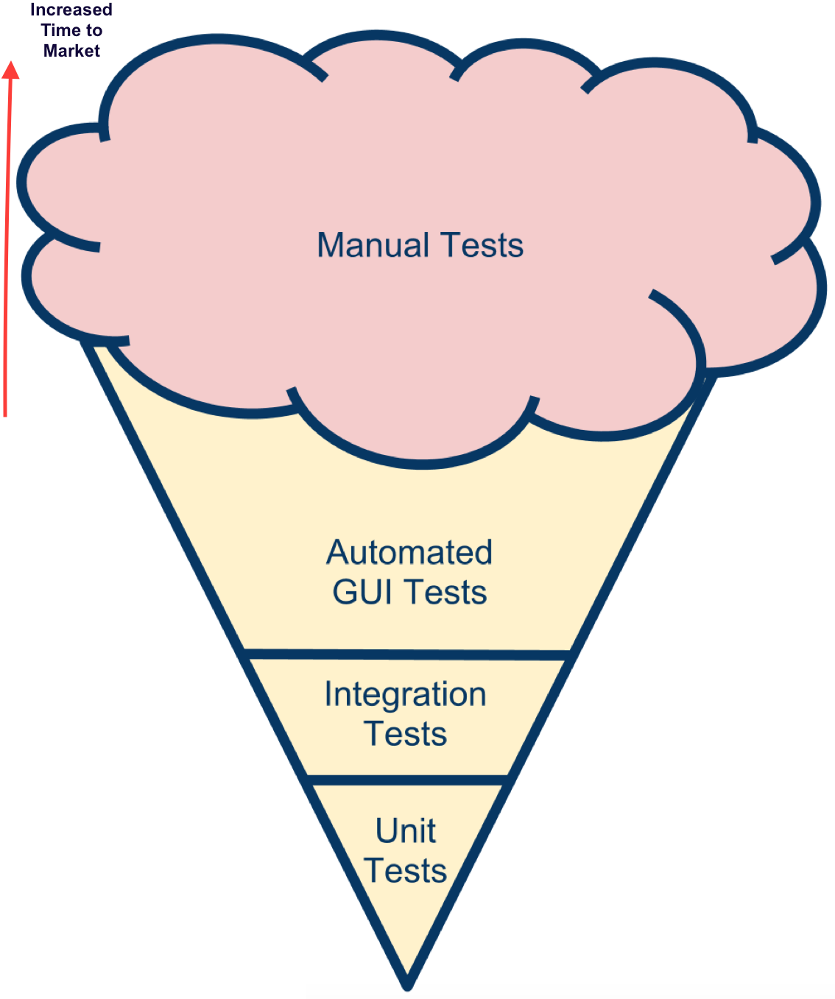
Be Careful of Ice-Cream Cone
Notes:
(*** Use humuour ***) We call this the ice cream but it does not taste as nice as it looks
High number of manual test dependency means increased test time before deploying to market

Slide 14
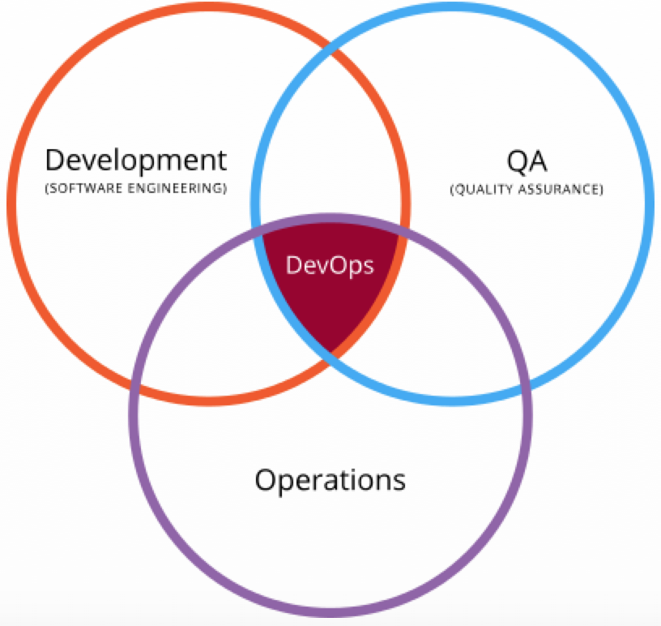
DevOps Supports Test Automation
DevOps is the practice of operations and development engineers participating together in the entire service lifecycle, from design through the development process to production support.
Notes:
Tutorial TPI NEXT for BRATESTE 2011
3/16/16
© Polteq Test Services B.V. 2011
‹#›
Dev + Operations collaboration
DevOps includes all people involved development of the product from start to finish
Modern dev environment (Puppet,Chef,Ansible,Saltstack)
* Stress > Infrastructure as code > config management scripts as part of source control(GIT) right along side the code it runs with
CI, Automated testing - immediate feedback to developers, don’t deploy broken code ( Make it visible)
Deploy code to target systems
Generate production move packages
CD -

Slide 15
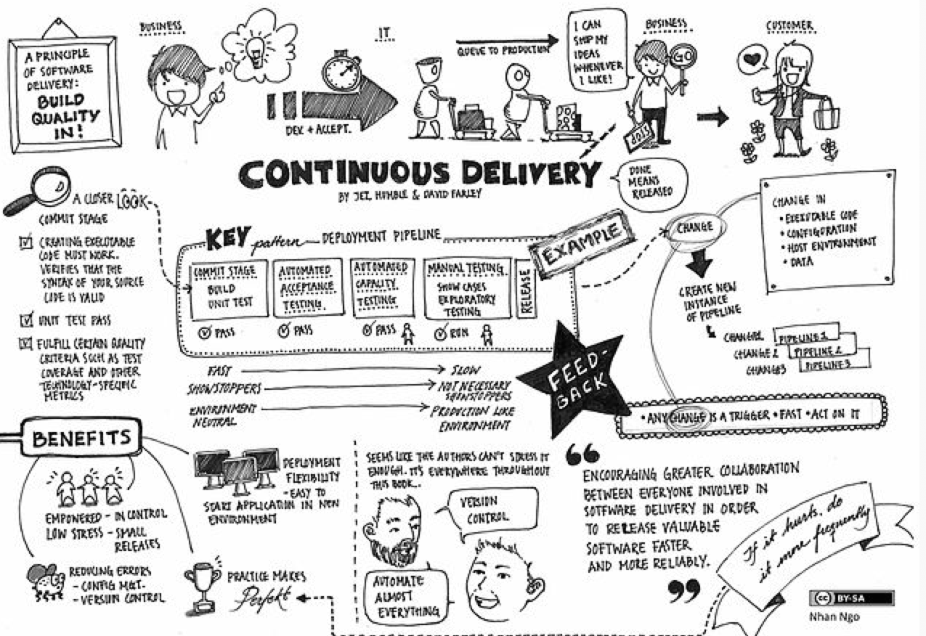
Notes:
Team approach encourages greater collaboration
Support activities like DevOps are crucial in making this a success
Iterative development approach

Slide 16
Benefits of Test Automation
Improved time to market
Optimisation of speed, efficiency, quality and decreased costs
Competitive advantage
Notes:
Tutorial TPI NEXT for BRATESTE 2011
3/16/16
© Polteq Test Services B.V. 2011
‹#›
Bring benefits of TA back to digital transformation
Relate to issues on client projects

Slide 17
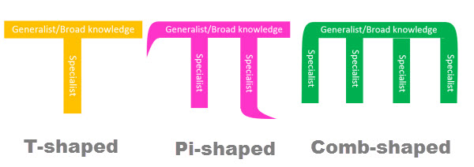
Cross-Skilling Facilitates Test Automation
Notes:
Tutorial TPI NEXT for BRATESTE 2011
3/16/16
© Polteq Test Services B.V. 2011
‹#›

Slide 18
QA Roles Facilitates Test Automation
https://www.thoughtworks.com/insights/blog/qa-dead
Notes:
Tutorial TPI NEXT for BRATESTE 2011
3/16/16
© Polteq Test Services B.V. 2011
‹#›
Quality Analyst
Complex interactions, users unexpected, fail unpredictably. Asks questions early - save time
Quality Assurer
Help build quality. Not quality control, build quality from start, not rejects new features because of poor quality, help to produce quality, automated tests before dev, safety net, tricky scenarios
Quality Ambassador
Your job is to help the whole team own the quality of the work. Inspire. Share their knowledge and prod others to pick up habits that help improve the quality of their work.

Slide 19
Conclusion
Biggest technical challenge in the digital transformation journey is an over-reliance on manual testing
Adopting a full automation strategy
Results in reduced costs, quicker time to market and competitive advantage
Can test automation contribute towards a successful digital transformation journey?
Notes:
Tutorial TPI NEXT for BRATESTE 2011
3/16/16
© Polteq Test Services B.V. 2011
‹#›
Single take Away
~Time and Cost benefits of TA
Speed to market
Deliver faster
Maintain quality & user experience

Slide 20
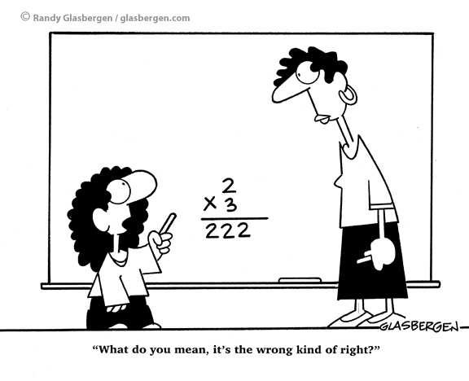
Q-C-A
@tester_RSA
sinclair@thoughtworks.com
waynesinclair.co.za
@Zululegend
mradebe@thoughtworks.co.za
mradebe@thoughtworks.com
Notes:
Tutorial TPI NEXT for BRATESTE 2011
3/16/16
© Polteq Test Services B.V. 2011
‹#›
Add previous links also
WQ report
QA Roles
**** Add any other links here

